Slide 1


Leveraging Analytics to Deliver Sustained Growth
By: Royal Caribbean Analytics Center of Excellence
Team Members- Venkat Gopalakrishnan, Justin Kroenert, Ashish Mahadik, Dan Olmsted, Sammazo Plamin, Anupriya Thirumurthy
Prepared For: Roger Moore , CFO
July 28, 2018

Slide 2
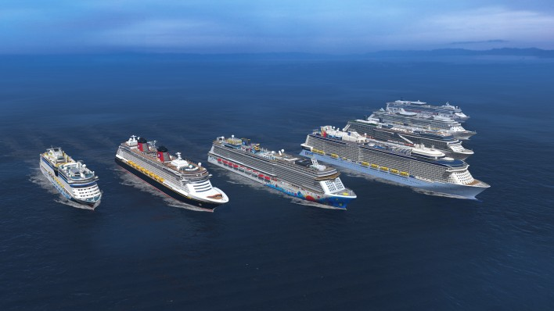
Agenda
Executive Summary
Driver Tree
Analytical Opportunity
Evaluation
Conclusion
Appendix

Slide 3
Executive Summary
Every day Royal Caribbean collects and processes seven billion data points to deliver real-time guidance to captains to optimize routes
Manages a high volume of social interactions and conducts sentiment analysis to better understand customer needs
However, there is untapped potential
Identified five analytical opportunities which align with our overarching business strategy
Implementing Targeted Advertising will give us a competitive advantage over our main competitors and result in the highest return on investment
http://www.rclcorporate.com/data-in-the-palm-of-your-hand/

Slide 4
Analytical Opportunity
Evaluation
Conclusion
Appendix
Driver Tree
Driver Tree Reveals Five Opportunities
Profit
Increase Revenue
Predictive Maintenance
Decrease Cost
Predict Likelihood of Returning Customers
Customer Segmentation
Targeted Advertisement
Energy Efficient Ships

Slide 5
Attract New Customers and Increase Recurring Customer Rate
Analytical Opportunity
Evaluation
Conclusion
Appendix
Driver Tree
Business Problem
Low Recurring Rate
• One time customer
Analytical Solution
• Predict customer likelihood to come back
Impact
• Increase retention rate and trip frequency
Advertising the wrong area of the product
Improve customer satisfaction by knowing what matters
Opportunity to increase brand value satisfaction
The customers want to explore competitors
Identify key factors for why customers come back
Develop promotional package to target at risk (one time) customers and prospective customers

Slide 6
Better Customer Insights by Segmentation
Analytical Opportunity
Evaluation
Conclusion
Appendix
Driver Tree
Business Problem
Analytical Solution
Establish customer data collection process
Develop clustering algorithm
Derive patterns from output clusters
Impact
Communication strategies that resonate with target audiences
Divide market into workable customer segments
Better understanding of consumer data
Perform consumer assessment
Develop Customer Insights
Improve Customer Engagement
Improve Brand loyalty
Create popular service packages
Target high value customers
Use untraditional customer behavior characteristics

Slide 7
Targeted Advertising Can Tap Into Underserved Markets & Grow Revenue
Analytical Opportunity
Evaluation
Conclusion
Appendix
Driver Tree
Business Problem
The cruise industry has not been attracting younger vacationers as seen by a rising average customer age
Analytical Solution
Use targeted advertising on travel blogs and travel websites targeting this demographic
Impact
Tapping into a large potential market has immediate revenue benefits
An older and shrinking clientele could someday be devastating given the large fixed costs of owning an ocean cruise vessel
Customize the ads to various subgroups, highlighting their likely preferences in a vacation
With a good first experience, this younger generation may take many cruises over their longer lifetimes
Being more active on social media, satisfied Millennials could be great ambassadors for our brand

Slide 8
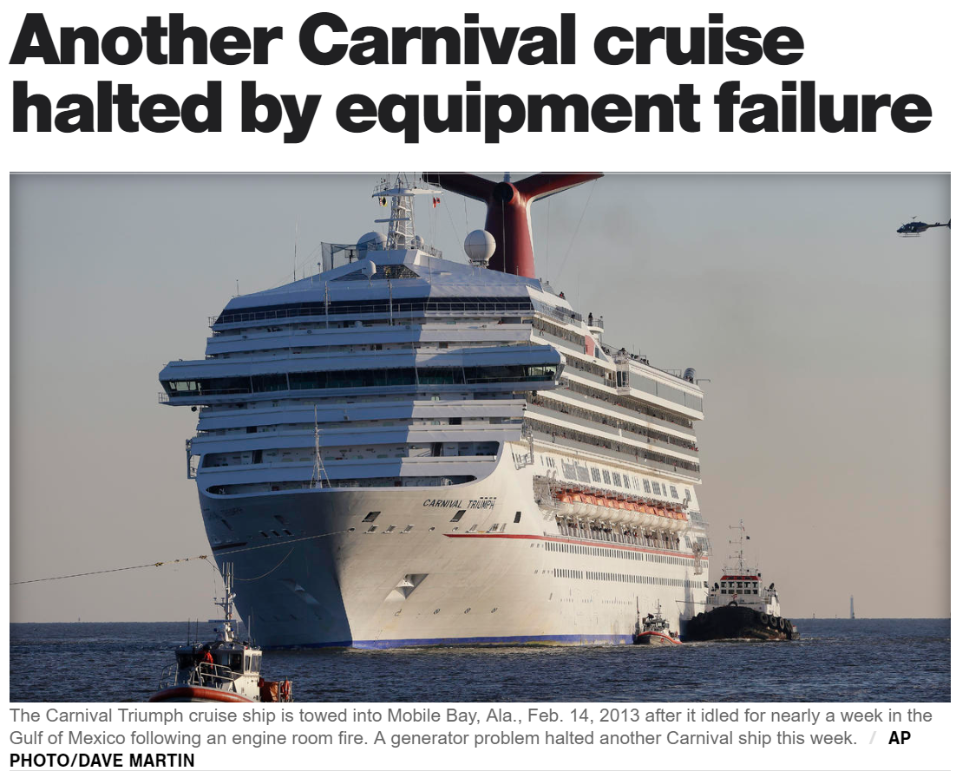
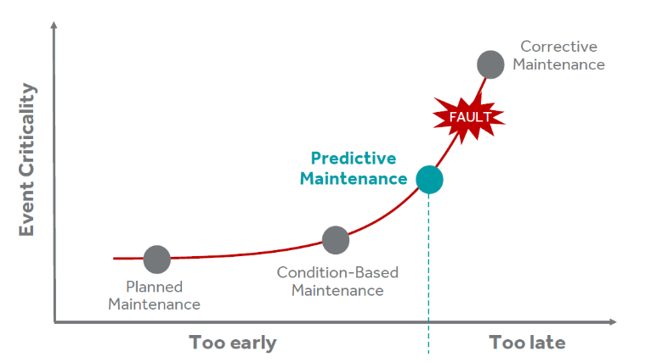
Predictive Maintenance Can Drastically Reduce Costs and Improve Customer Experience
Analytical Opportunity
Evaluation
Conclusion
Appendix
Driver Tree
Business Problem
Analytical Solution
Predict Remaining Useful Life (RUL) with regression
Impact
Increased passenger safety
Causes delays and discomfort
Negative press
Optimize the periodic maintenance operations
Major cost savings:
Reduces the frequency of maintenance
Minimizes the time spent maintaining equipment
Minimizes the cost of maintenance
Unplanned equipment failure
Install sensors on critical equipment to monitor data in real time
Lawsuits and declining sales
Notes:
The Carnival Triumph, with over 4,000 passengers aboard, idled for nearly a week in the Gulf of Mexico following an engine room fire and was being towed to port in Mobile, Ala. As passengers came within sight of land and a cellphone signal, a clearer picture of the scene aboard the ship began to emerge. They described overflowing toilets, sewage backed up in showers, scarce food, people getting sick and a tent city on what was supposed to be a tanning deck.

Slide 9
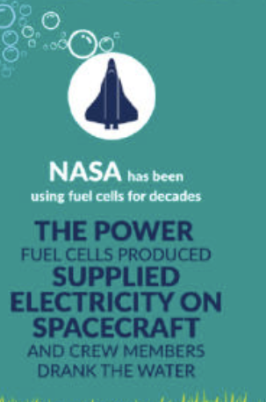
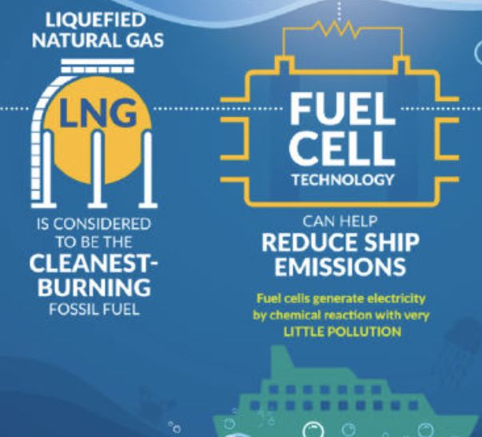
Energy Efficient Optimization modelling can Reduce Fuel Costs
Analytical Opportunity
Evaluation
Conclusion
Appendix
Driver Tree
Business Problem
The need for an innovative and energy efficient cruising technique binded with consumption optimization.
Analytical Solution
Predictive modelling to find a route based energy efficient cruising technique.
Impact
Clean fuel and simpler machinery means less machine maintenance. This in turn contributes to major cost saving by reducing the number of days in drydock.
Create optimization models to minimize the amount of energy use*
Balance between choice of energy to increase power and propulsion Vs energy saving waste reduction techniques.
Enables additional energy saving possibilities through efficient use and reuse of resources.
Route specific energy cruising technique would greatly lessen the cost spent on fuel.
Major factors taken into consideration are bunkering availability, location specific fuel cost, governmental initiatives* and ease of use.
http://publications.lib.chalmers.se/records/fulltext/234063/234063.pdf
Notes:
Government initiatives* - Singaporean government, for instance, has provided several promotions for LNG fueled ships such as exemption of port fee for 5 years and a 2 million Singapore dollars loan (Wong, 2017). The Korean Government has started to take similar initiatives as well.
Minimize energy use* - 1. Switching to LED (less power required without reducing brightness; less heat - saves energy for air-conditioning)
2. Shape of the propulsion system to maximize performance that would result in energy savings.
3. Waste cooking oil could be used as a lubrication for machinery, thereby reducing cost.

Slide 10
Targeted Advertisement Scores high across all three Evaluation criteria
Analytical Opportunity
Evaluation
Conclusion
Appendix
Driver Tree
Opportunity | Profit Potential | Ease of Obtaining Data | Ease of Implementation | Average Score
Returning Customers | 3 | 2 | 3 | 2.67
Customer Segmentation | 4 | 3 | 4 | 3.67
Targeted Advertisement | 4 | 4 | 4 | 4
Predictive Maintenance | 3 | 1 | 3 | 2.33
Energy Efficient Ships | 2 | 2 | 1 | 1.67
1 = least impactful
5 = most impactful

Slide 11
Targeted Advertisements offers the Greatest Value
Analytical Opportunity
Evaluation
Conclusion
Appendix
Driver Tree
Revenue Potential
Ease of Implementation
Available Data
Appeal to a wider audience of potential customers by featuring various ads to different demographics
Differentiate Royal Caribbean from its competitors
Attract more millennials to switch from Airbnb and package holidays
Targeted Advertisement

Slide 12
Appendix
Analytical Opportunity
Evaluation
Conclusion
Appendix
Driver Tree
http://www.rclcorporate.com/rcl-steps-to-the-fore-with-plans-for-fuel-cell-technology/
https://www.greenbiz.com/blog/2014/10/06/carnival-cruises-towards-25-billion-fuel-savings
https://www.veristar.com/portal/rest/jcr/repository/collaboration/sites/veristarinfo/web%20contents/bv-content/generalinfo/publications/bulletintechnique/BT_2012/Ship_12/modelling/documents/5464.2.Marty-IMDC2012.pdf
https://www.sciencedirect.com/science/article/pii/S2405896317314362

